Slide 1
Proposal
DS 105 machine learning
FINAL PROJECT

Slide 2
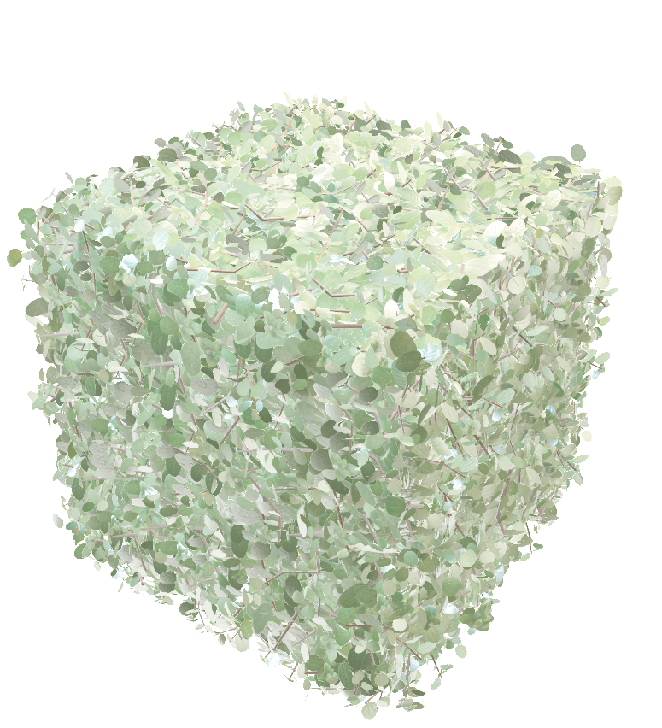

Dataset
Choice of my Data set will be on kaggle under healthcare-dataset-stroke-data
(WHO | Stroke: a global response is needed )
Base on my selection, I will be choosing this data set. According to the World Health Organization (WHO) stroke is the 2nd leading cause of death globally, responsible for approximately 11% of total deaths. This dataset is used to predict whether a patient is likely to get stroke based on the input parameters like gender, age, various diseases, and smoking status. Each row in the data provides relavant information about the patient.

Slide 3
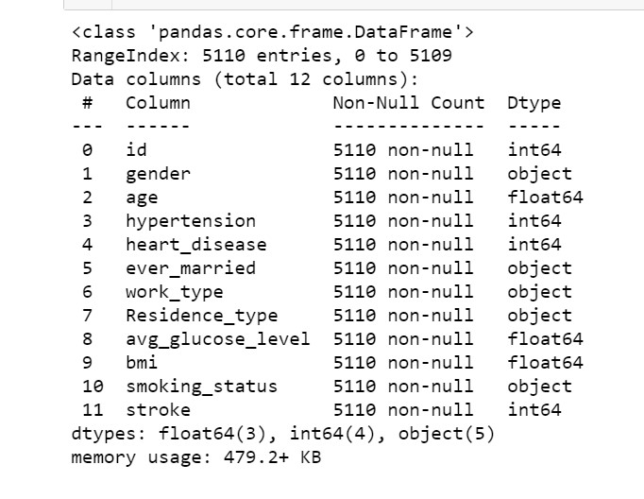
Samples dataset

Slide 4
Attributes
id: unique identifier
gender: "Male", "Female" or "Other“
age: age of the patient
hypertension: 0 if the patient doesn't have hypertension, 1 if the patient has hypertension
heart_disease: 0 if the patient doesn't have any heart diseases, 1 if the patient has a heart disease
ever_married: "No" or "Yes“
work_type: "children", "Govt_jov", "Never_worked", "Private" or "Self-employed“
Residence_type: "Rural" or "Urban“
avg_glucose_level: average glucose level in blood
bmi: body mass index
smoking_status: "formerly smoked", "never smoked", "smokes" or "Unknown"*
stroke: 1 if the patient had a stroke or 0 if not *Note: "Unknown" in smoking_status means that the information is unavailable for this

Slide 5
What is Stroke??
Stroke is a medical emergency. A stroke occurs when blood flow to a part of your brain is interrupted or reduced, preventing brain tissue from getting oxygen and nutrients. Brain cells begin to die within minutes.
Face – the face may have dropped on 1 side, the person may not be able to smile, or their mouth or eye may have dropped.
Arms – the person with suspected stroke may not be able to lift both arms and keep them there because of weakness or numbness in arm.
Speech – their speech may be slurred or garbled, or the person may not be able to talk at all despite appearing to be awake; they may also have problems understanding what you're saying to them.
Time – it's time to dial 995 immediately if you see any of these signs or symptoms.

Slide 6
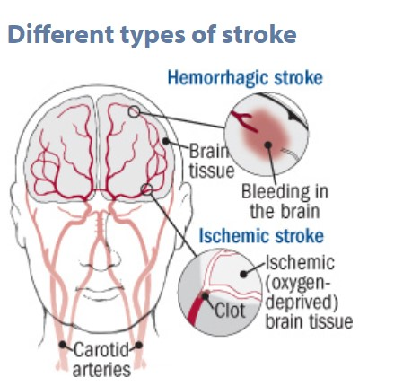
Different types of stroke
There are two main types of stroke. Ischemic strokes are more common and occur when a blood clot blocks an artery in the brain. In some cases, the clot develops in the vessel itself (thrombotic stroke). In other cases, the clot forms in the heart or in an artery that carries blood to the brain; the clot breaks off and travels to the brain, where it lodges in a small artery (embolic stroke). Hemorrhagic strokes occur when an artery in the brain ruptures, releasing blood into the brain tissue.

Slide 7
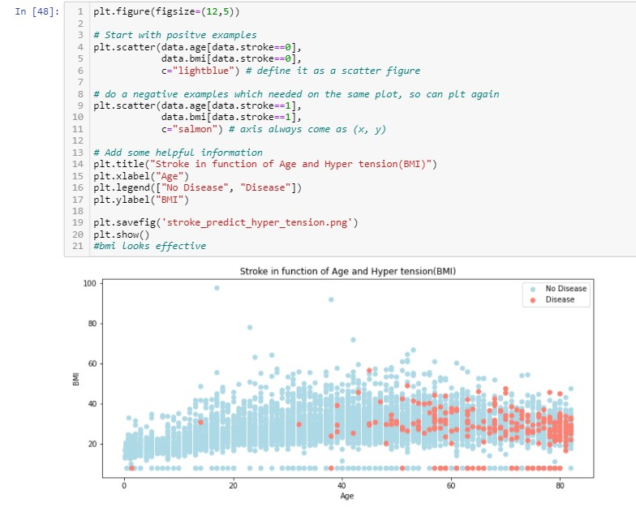


Overall Problem Statement
According to the World Health Organization (WHO) stroke is the 2nd leading cause of death globally, responsible for approximately 11% of total deaths, Can we predict stroke before it happens for better preventive healthcare?
Can we predict stroke before it happens for better preventive healthcare?

Slide 8

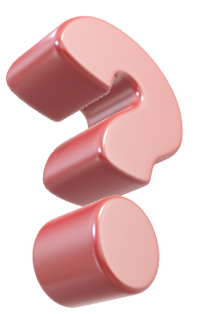
Questions
which company has stroke from least to highest?
Does age has impact on strokes? and How is this parameter distributed?
Who has the most risk on gender to had a heart disease, hypertension
Does urban or rural in resident type has high stroke rate?
What is the density of the bmi, age and Level of serum creatinine in the blood (mg/dL)
what is the Correlation with avg glucose level
Does smoker have high stroke rate compare to non smokers?

Slide 9
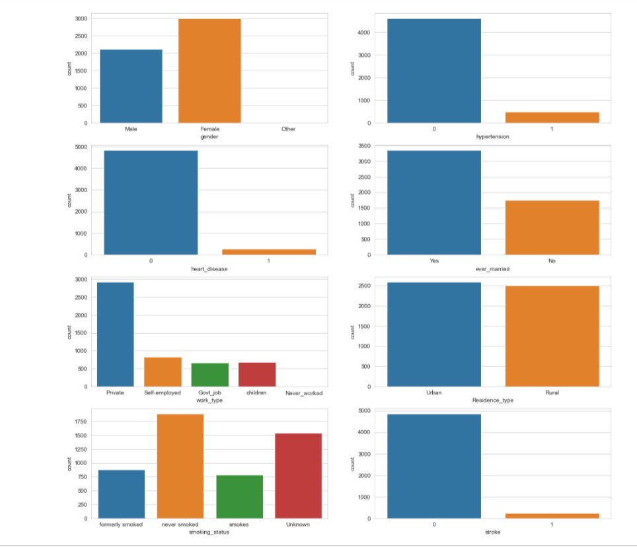
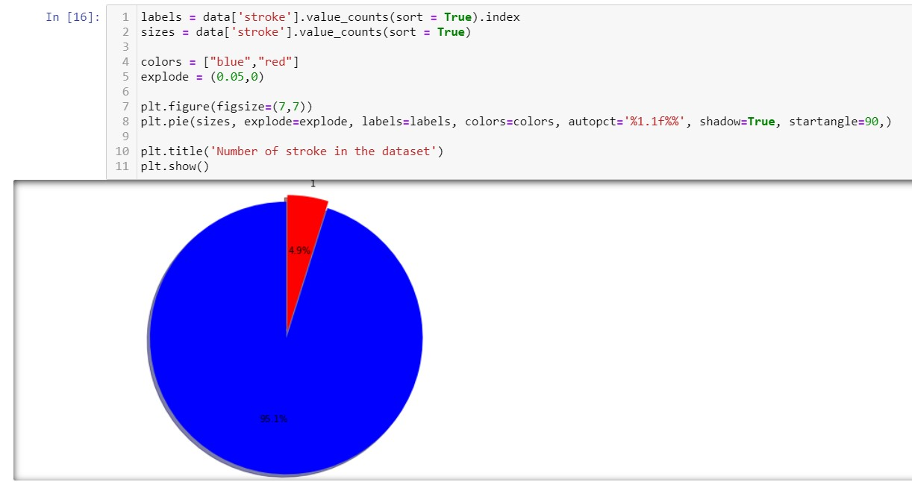
DATA Insights
From distribution it is clear that every 4.9percent out of 100 people are having strokes from ths sampling data. Moreover,this is a highly unbalanced data distribution, and null accuracy score of this distribution it self is 95.1%, whcih imploys any dump model should randomly predictions of stroke could reach accuracy of 95%. So, while modeling and training data, either over sampling or under sampling has to be done to obtain best results.

Slide 10
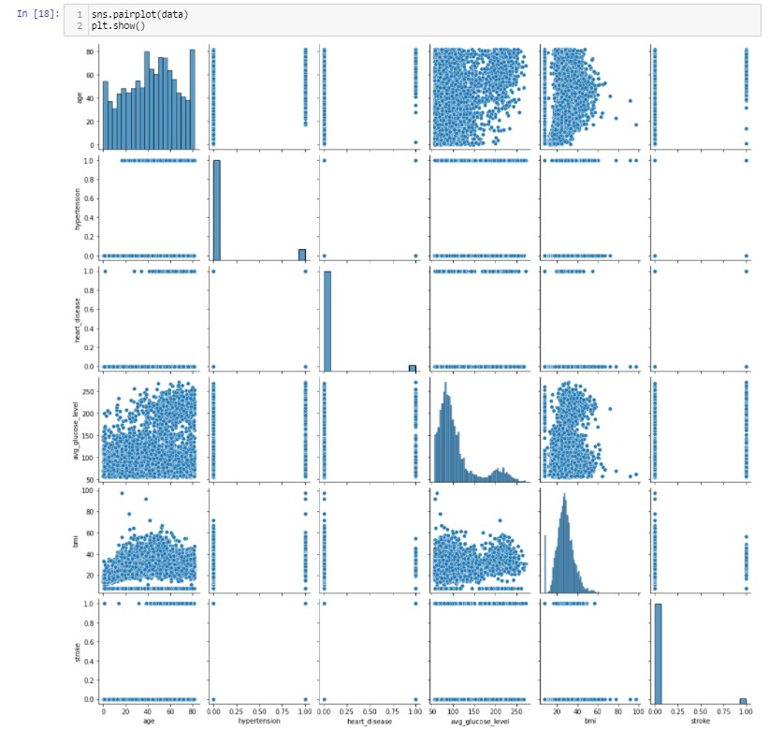
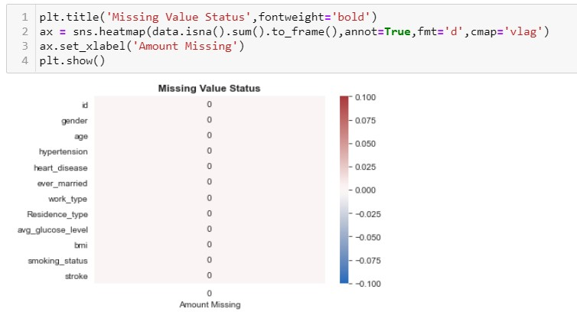
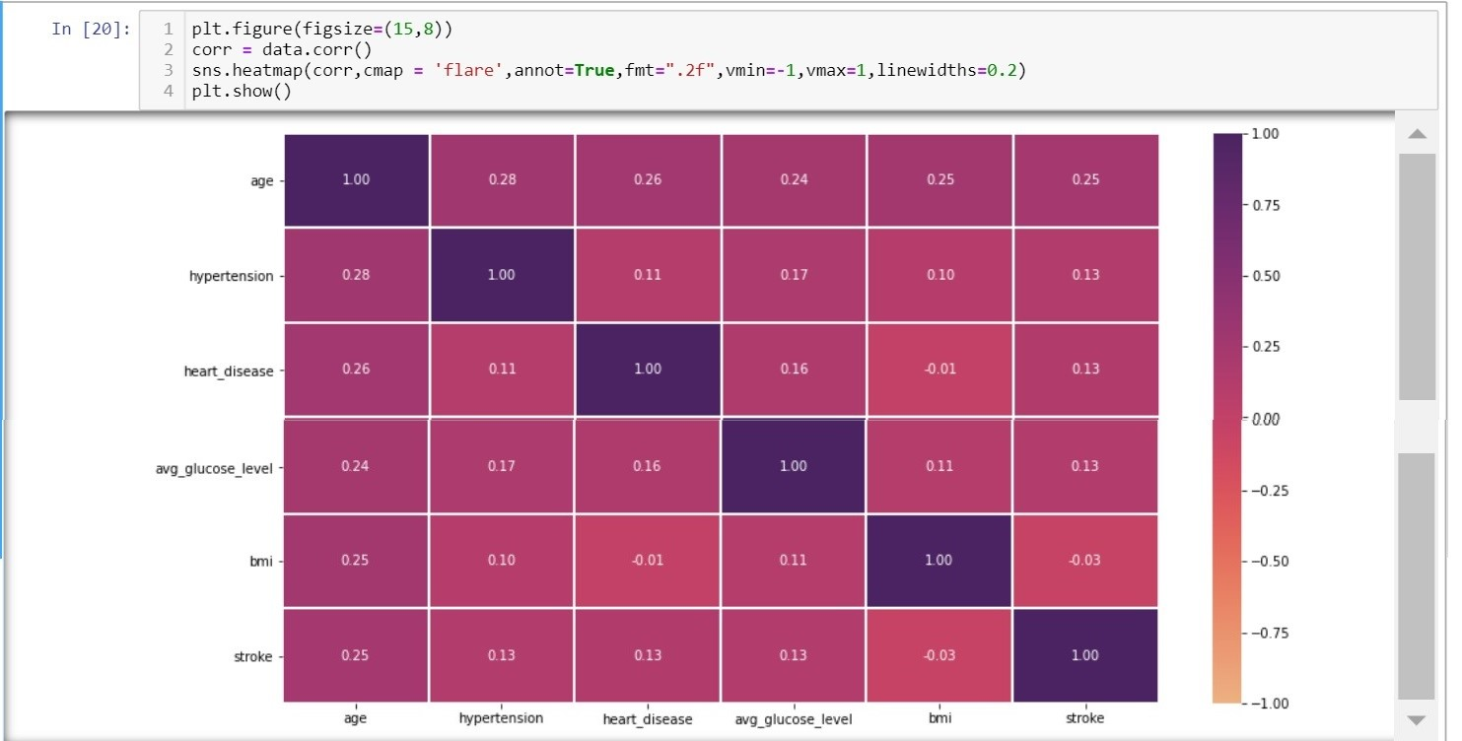
Data Processing
Age and stroke has strong correlation

Slide 11
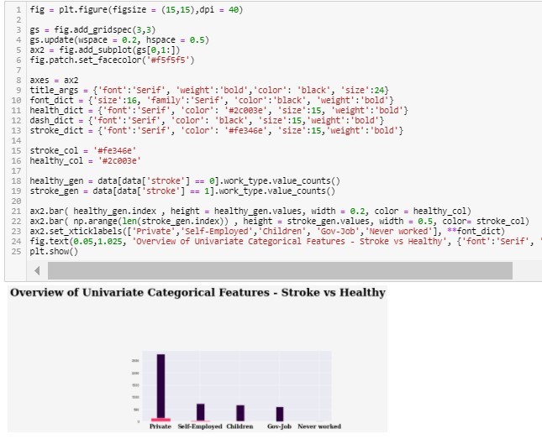
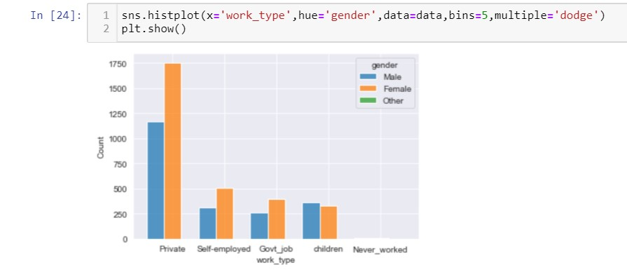
Overview of unicariate Categorical Featurees on storke vs healthy
as shown on the left side that in private secter and self employed person have more people having stroke
govt_job have a least stroke compare to the top 2 sector
children and never work are not very likely to get a stroke
this can explain that top sector have more stress and pressure then the other sector

Slide 12
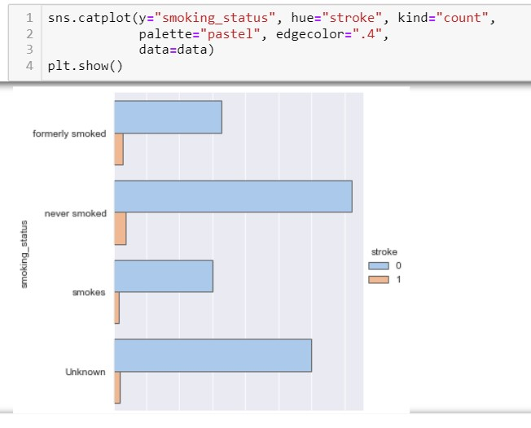
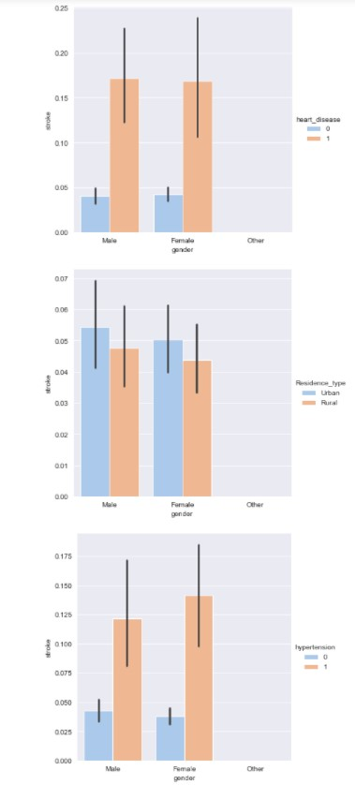
Plot smoking status, keep the 'unknown' observations, by doing this I treat smokers and non smokers as a one class, which would be alright if our variable is not important. #smoking is not good for health
as compared to smokers it seems that is not highly correlated.
Regardless of patient’s gender, and where they stayed, they have the same likelihood to experience stroke, the gender is not a feature that discriminate a person having a stroke or not Hypertension and heart disease features are correlated to stroke

Slide 13
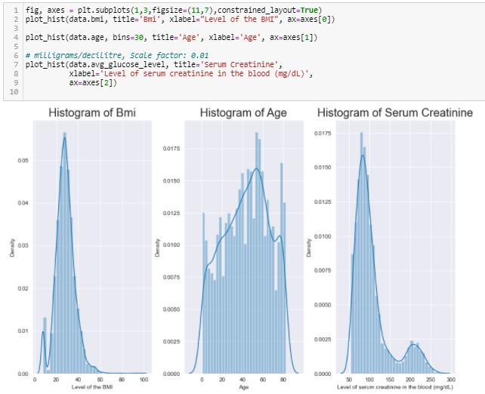
Based on the above plots, it seems clear that Age is a big factor in stroke patients - the older you get the more at risk you are. there are also differences in Avg. Glucose Levels and BMI.

Slide 14
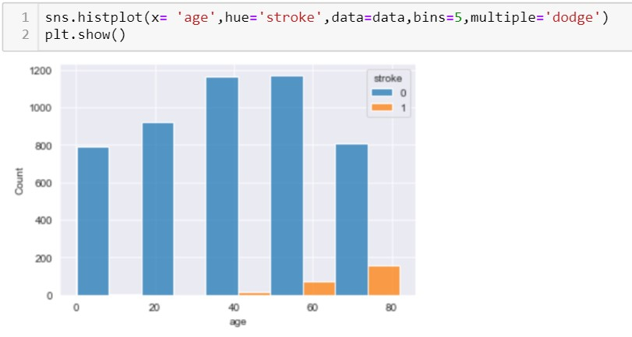
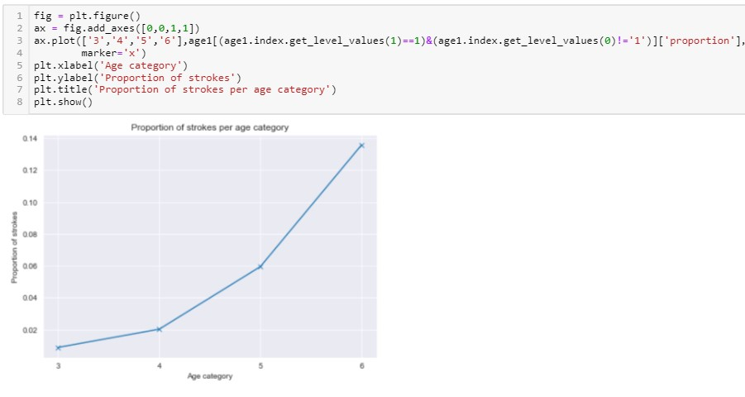
It is obvious that older age people are more exposed to the risk of stroke
i define age split where 0 is refer to no stroke and 1 is stroke, to plot the proportion, According to the Data, out of 100 person older than 60 year approx 14 had a stroke

Slide 15
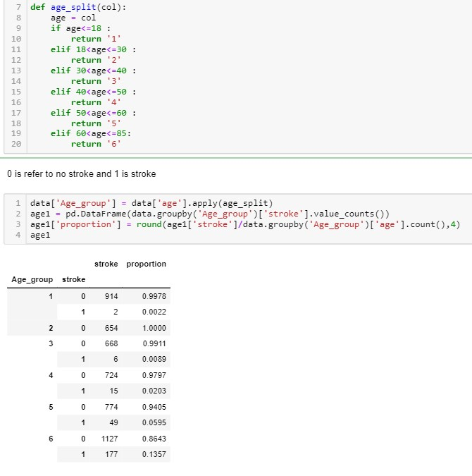
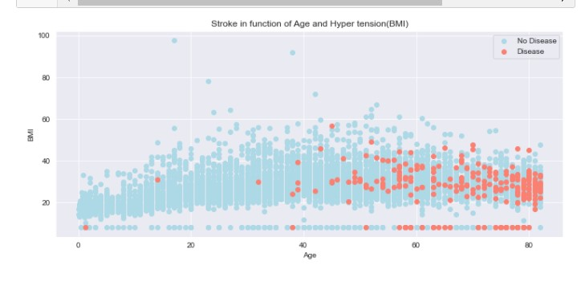
I did a ploting on prediction on age and bmi, as you can
See that the older you are, the chances of getting
Stroke/heart disease/ hypertension is higher.

Slide 16
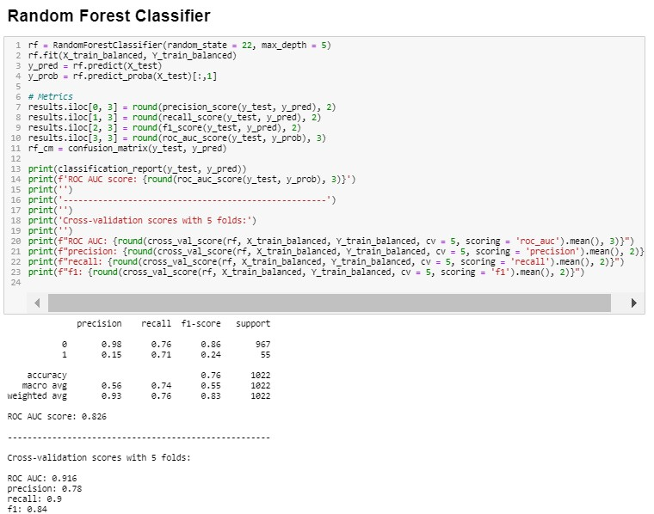
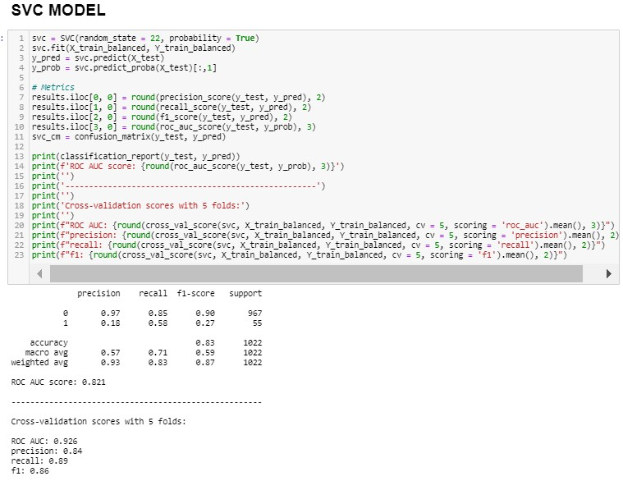
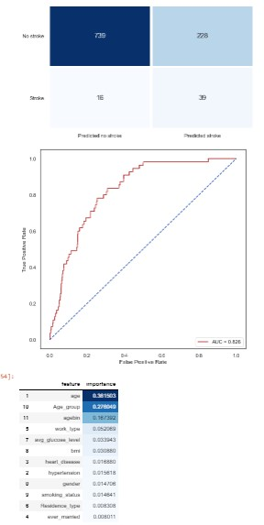
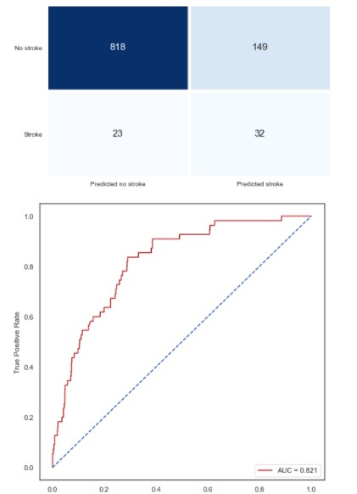
This means that 20% of the data is using for testing, this is usually pretty accurate. However, if your dataset size increases dramatically, like if you have over 100,000 instances, it can be seen that a 10 fold cross validation would lead in fold of 10,000 instances

Slide 17
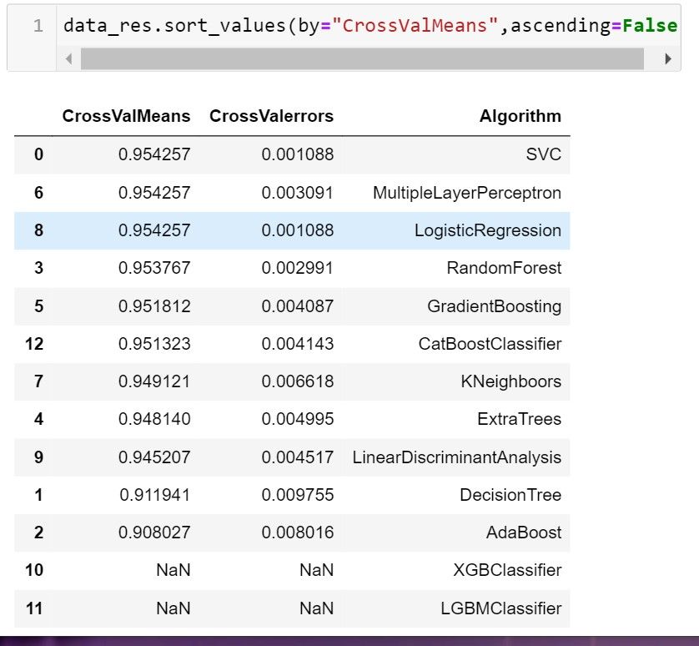
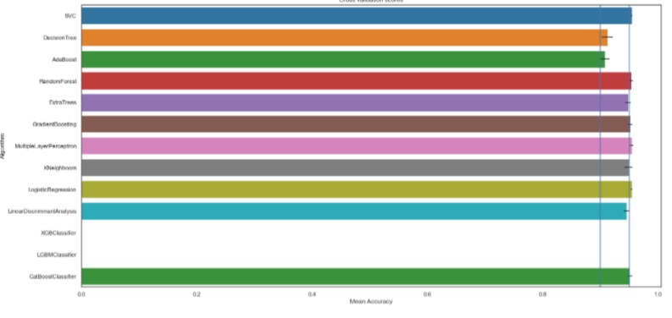
Data sampling is a technique where we either populate or reduce our data to make it balance. This is called oversampling and undersampling in general. Whereas model modifications are involved in the implementation of folds and cross-validation techniques
Using recall will be a good evaluation matric but precision and recall will be able to work hand in hand.
i will be trying 5 modeling:KNN, Logistic Regression, Random Forest Classifier, XGBClassifier, LGBMClasifier
To do testing
I will choose SCV classifier i will be using svc algorithm compare to others as the cross valmeans is higher compare to others, the value error is lesser too

Slide 18
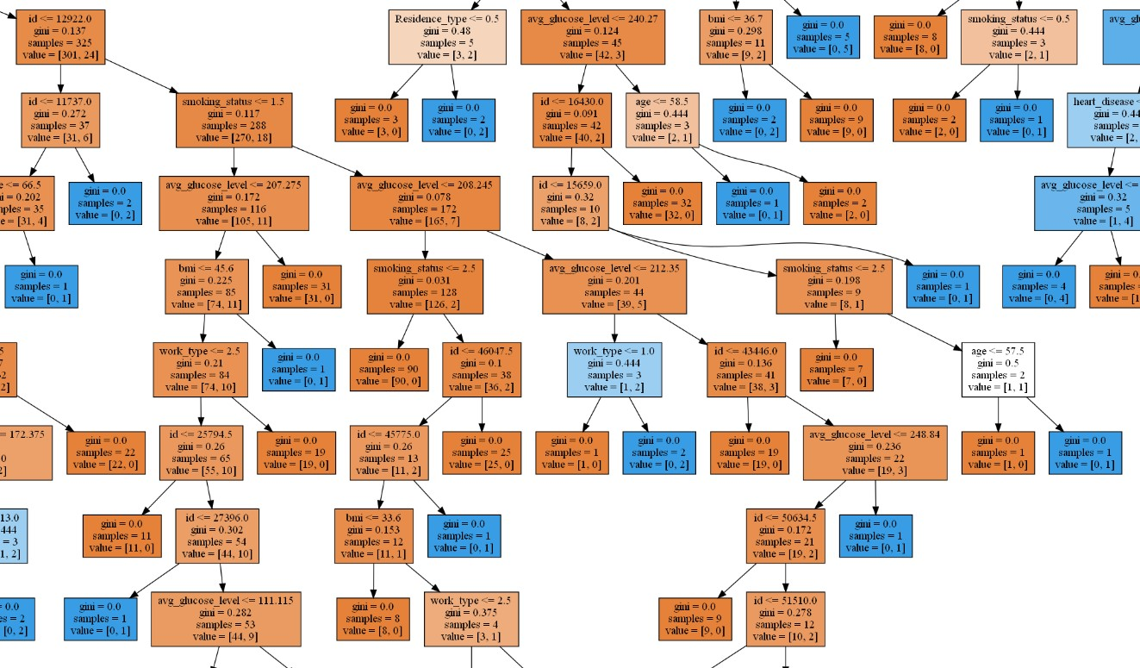
XGBoost is a tree based ensemble machine learning algorithm which is a scalable machine learning system for tree boosting. XGBoost stands for Extreme Gradient Boosting. It uses more accurate approximations to find the best tree model.
Approximate Greedy Algorithm: The decision to stop growing using threshold that gives the largest gain is made without knowing about how the leaves will be split later. This is known as Greedy Algorithm. It has to check every possible threshold which is time consuming too. Approximate Greedy Algorithm overcomes this tiring process by, dividing the data into Quantiles or uses quantiles as candidate thresholds to split. By default, it uses about 33 quantiles.
Important Parameters of XGBoost
When you have large number of observations in training data.
Number features < number of observations in training data.
It performs well when data has mixture numerical and categorical features or just numeric features.
When the model performance metrics are to be considered

Slide 19
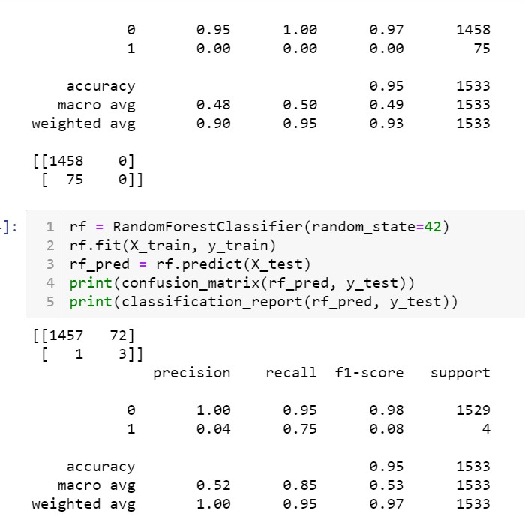
With imbalanced data, the accuracy is not a metric that we can take into account because it is based on the the larger part of the target. In other words, this model is very accurate predincting when a people is not having a stroke, which is obviously what i don't need.
The poor result in class 1 of the target is expected because of the imbalanced dataset as well as the limited correlation among the variables.

Slide 20
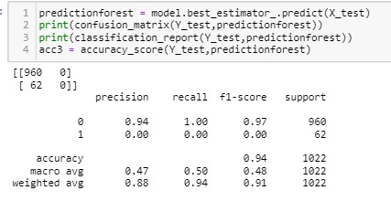
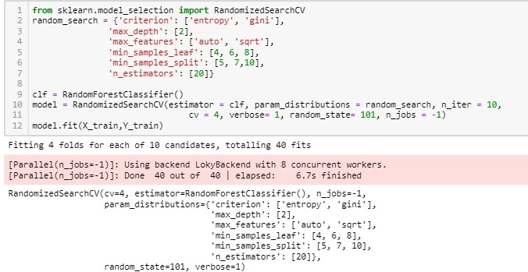
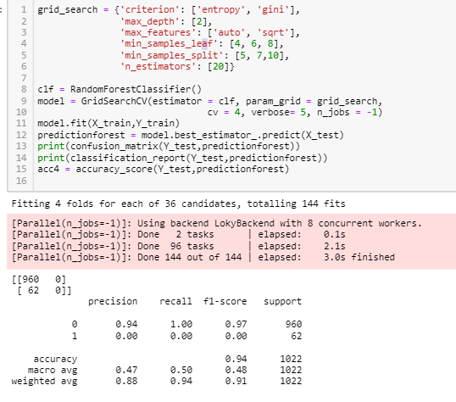
In Random Search, we create a grid of hyperparameters and train/test our model on just some random combination of these hyperparameters. In this example, I additionally decided to perform Cross-Validation on the training set.
In Grid Search, we set up a grid of hyperparameters and train/test our model on each of the possible combinations. In order to choose the parameters to use in Grid Search, we can now look at which parameters worked best with Random Search and form a grid based on them to see if we can find a better combination.
.

Slide 21
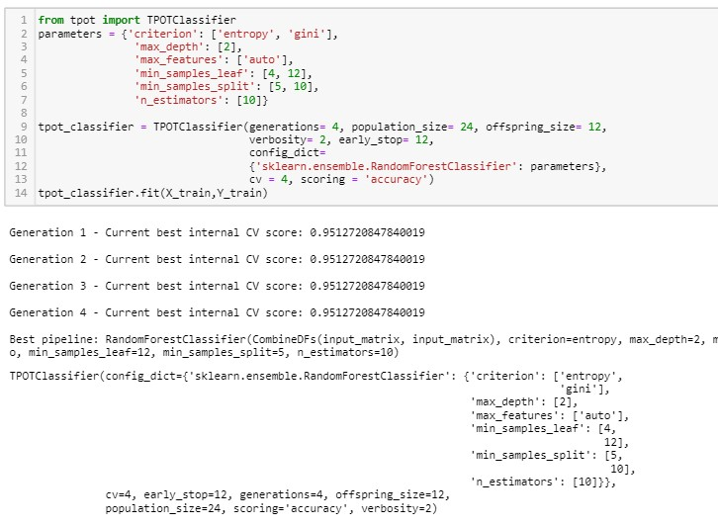
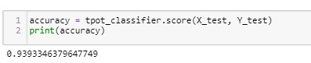
AUTOMATED HYPER-PARAMETER TUNING
i create a population of N Machine Learning models with some predefined Hyperparameters, then calculate the accuracy of each model and decide to keep just half of the models (the ones that perform best).now i generate some offsprings having similar Hyperparameters to the ones of the best models so that to get again a population of N models. At this point, we can again calculate the accuracy of each model and repeat the cycle for a defined number of generations. In this way, just the best models will survive at the end of the process.
In order to implement Genetic Algorithms in Python, I can use the TPOT Auto Machine Learning library. TPOT is built on the scikit-learn library and it can be used for either regression or classification tasks.
The report and the best parameters are identified above using Genetic Algorithms.
The overall accuracy of our Random Forest Genetic Algorithm optimized model is shown below.

Slide 22
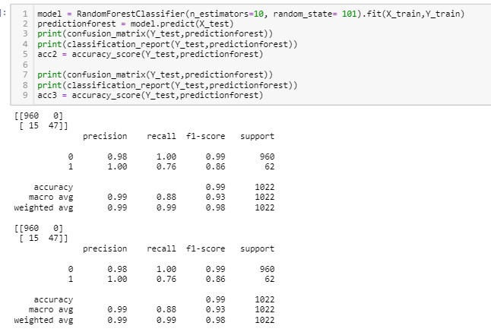
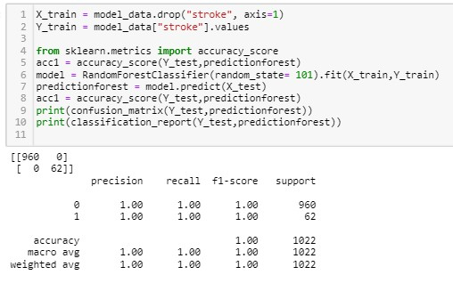
i choose some model hyperparameters based on my judgment/experience,i then train the model, evaluate its accuracy and start the process again. This loop is repeated until a satisfactory accuracy is scored.
The main parameters used by a Random Forest Classifier are:
criterion = the function used to evaluate the quality of a split.
max_depth = maximum number of levels allowed in each tree.
max_features = maximum number of features considered when splitting a node.
min_samples_leaf = minimum number of samples which can be stored in a tree leaf.
min_samples_split = minimum number of samples necessary in a node to cause node splitting. n_estimators = number of trees in the ensemble.

Slide 23
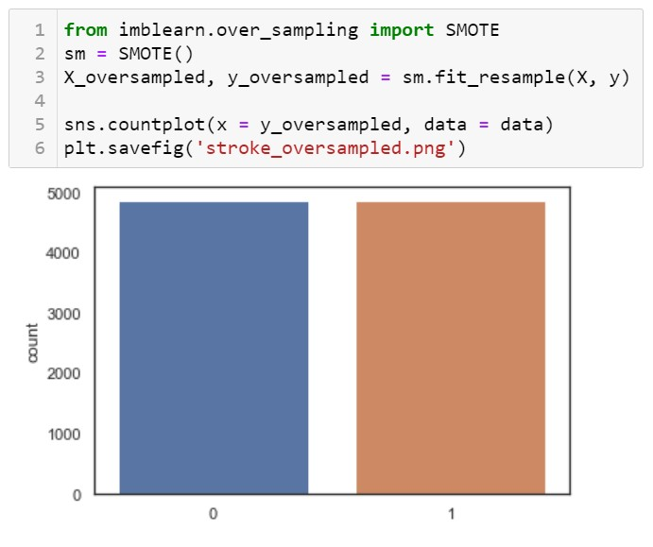
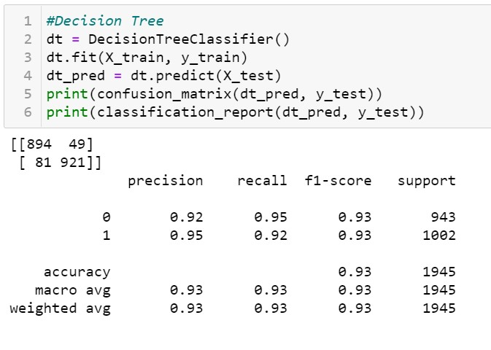
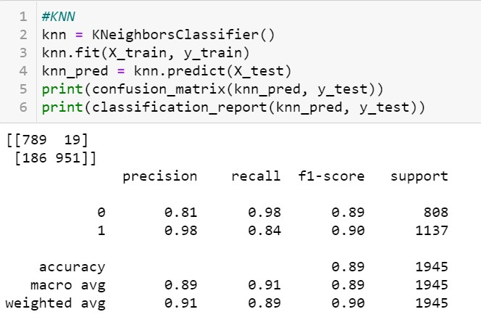
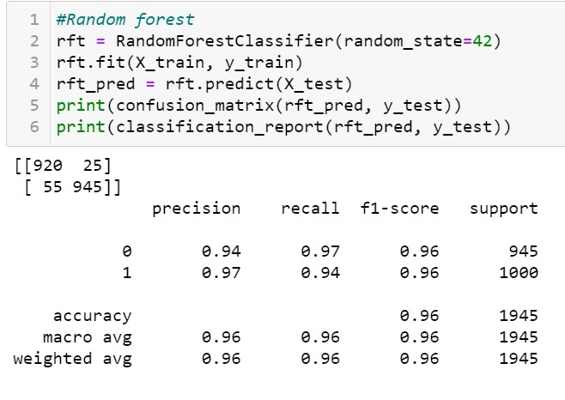
So after checking some of the algorithms , i have found that Random Forest has the highest accuracy.
Random forest is a supervised learning algorithm which is used for both classification as well as regression. But however, it is mainly used for classification problems. As we know that a forest is made up of trees and more trees means more robust forest.
The random forest is a classification algorithm consisting of many decisions trees. It uses bagging and feature randomness when building each individual tree to try to create an uncorrelated forest of trees whose prediction by committee is more accurate than that of any individual tree.
What do we need in order for our random forest to make accurate class predictions?
We need features that have at least some predictive power. After all, if we put garbage in then we will get garbage out.
The trees of the forest and more importantly their predictions need to be uncorrelated (or at least have low correlations with each other). While the algorithm itself via feature randomness tries to engineer these low correlations for us, the features we select and the hyper-parameters we choose will impact the ultimate correlations as well.

Slide 24
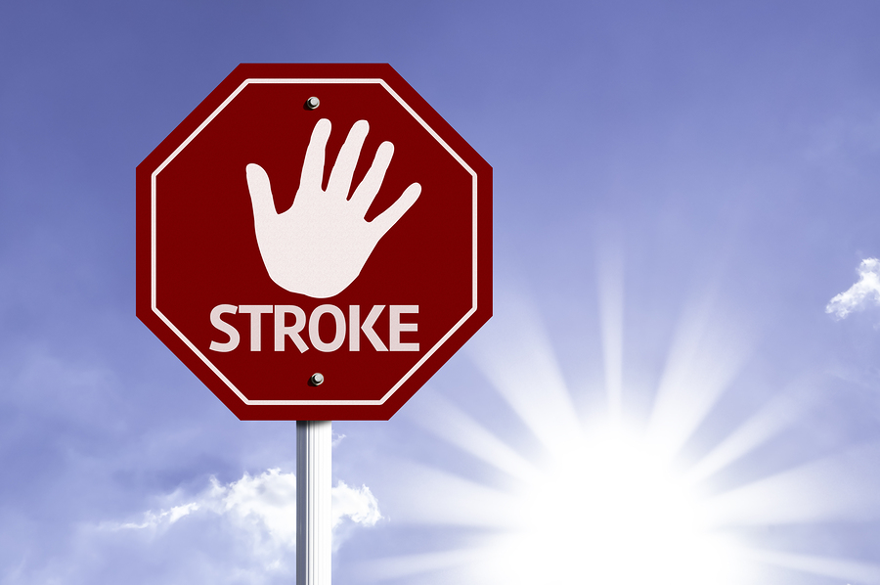
What can you do to prevent stroke? Age makes us more susceptible to having a stroke, as does having a mother, father, or other close relative who has had a stroke.You can't reverse the years or change your family history, but there are many other stroke risk factors that you can control—provided that you're aware of them. Knowledge is power. If you know that a particular risk factor is sabotaging your health and predisposing you to a higher risk of stroke, you can take steps to alleviate the effects of that risk.
How to prevent stroke
Here are few ways to start reining in your risks today to avoid stroke, before a stroke has the chance to strike.
Excercise
Exercise contributes to losing weight and lowering blood pressure, but it also stands on its own as an independent stroke reducer.
Do not drink
If you drink, do it in moderation, Drinking a little alcohol is okay, and it may decrease your risk of stroke. Studies show that if you have about one drink per day, your risk may be lower. Once you start drinking more than two drinks per day, your risk goes up very sharply.
Lost weight
Obesity, as well as the complications linked to it (including high blood pressure and diabetes), raises your odds of having a stroke. If you're overweight, losing as little as 10 pounds can have a real impact on your stroke risk
Signs of a stroke include:
weakness on one side of the body
numbness of the face
unusual and severe headache
vision loss
numbness and tingling
unsteady walk.

